Slide 1


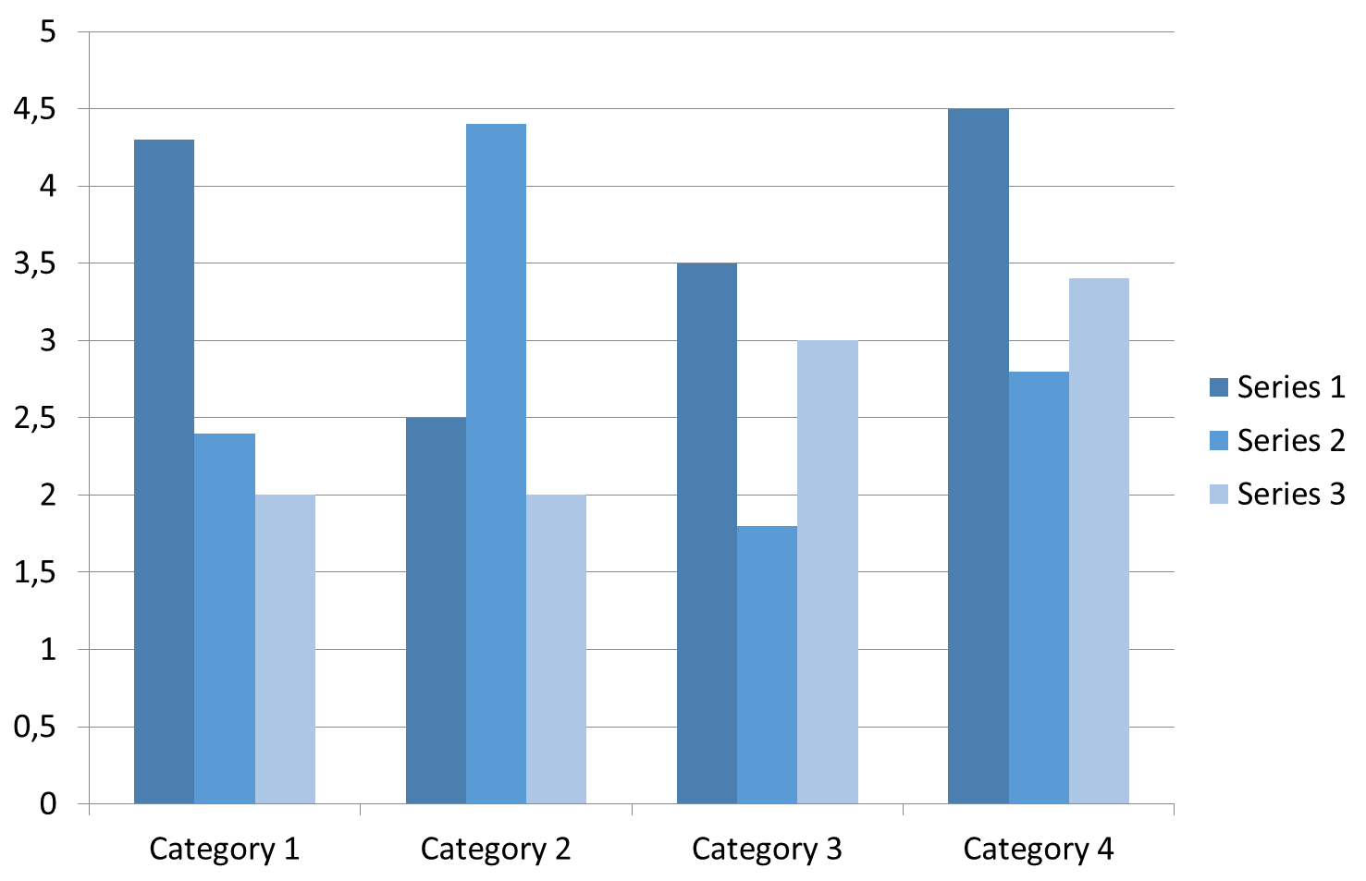


TITLE OF THE E-POSTER
Full name of the participant
Organization
Introduction
Materials and methods
In the introduction, you can specify:
Description of the problem associated with the research or the establishment of a scientific context.
Description of the white spots in the problem or what has not been done yet.
Formulation of the research objective.
Assessment of the importance of research.
The approximate structure of the section:
The general scheme of the experiment.
Populations/samples.
Location of the research area.
Limitations.
Sampling methodology.
Sample processing/preparation.
Materials.
Variables and measurements.
Statistical processing.
Results and discussion
The results are given in the processed version in the form:
-tables,
-charts,
-diagrams,
-equations,
-photographs,
-drawings, etc.
Discussion is about ideas, assumptions about the facts obtained, and a comparison of our own results with those of other authors.
Diagram 1. Name of the diagram
 | Heading | Heading | Heading
Item | 800 | 790 | 4001
Item | 356 | 856 | 290
Item | 954 | 875 | 976
Item | 324 | 325 | 301
Item | 199 | 137 | 186
Table 1. Name of the table
Conclusion
In conclusion, you can:
summarize the results;
suggest a practical application;
suggest a direction for future research.
KARAGANDA, APRIL 17, 2026

